Slide 1
CMSC201
Computer Science I for Majors
Lecture 20 – Recursion

Slide 2
Last Class We Covered
Python’s standard library
Importing modules
“Random” numbers
  Pseudo randomness
  Seeding the RNG
  Generating random numbers/choices
    Three different methods

Slide 3
Any Questions from Last Time?

Slide 4
Today’s Objectives
To introduce recursion
To better understand the concept of “stacks”
To begin to learn how to “think recursively”
  To look at examples of recursive code
  Summation, factorial, etc.

Slide 5
Introduction to Recursion

Slide 6
What is Recursion?
In computer science, recursion is a way of thinking about and solving problems
It’s actually one of the central ideas of CS
In recursion, the solution depends on solutions to smaller instances of the same problem

Slide 7
Recursive Solutions
When creating a recursive solution, there are a few things we want to keep in mind:
  We need to break the problem into
  smaller pieces of itself
  We need to define a “base case” to stop at
  The smaller problems we break down into need to eventually reach the base case

Slide 8
Normal vs Recursive Functions
So far, we’ve had functions call other functions
  For example, main() calls the square() function
A recursive function, however, calls itself
main()
square()
compute()

Slide 9
Why Would We Use Recursion?
In computer science, some problems are more easily solved by using recursive methods
For example:
  Traversing through a directory or file system
  Traversing through a tree of search results
  Some sorting algorithms recursively sort data
For today, we will focus on the basic structure of using recursive methods

Slide 10
Toy Example of Recursion
  def compute(intInput):
  print(intInput)
  if (intInput > 2):
  compute(intInput-1)
  def main():
  compute(50)
  main()
This is where the recursion occurs.
You can see that the compute() function calls itself.
What does this program do?
This program prints the numbers from 50 down to 2.

Slide 11
Visualizing Recursion
To understand how recursion works, it helps to visualize what’s going on.
Python uses a stack to keep track of function calls
A stack is an important computer science concept
To help visualize, we will

Slide 12
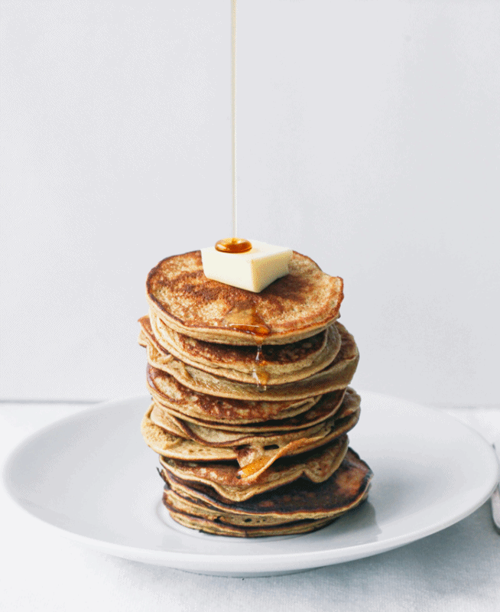
Stacks
Image from www.topwithcinnamon.com
Notes:
http://www.topwithcinnamon.com/2013/01/2-ingredient-healthy-pancakes-gluten-free-dairy-free.html
http://i1.wp.com/www.topwithcinnamon.com/wp-content/uploads/2013/01/OMFGTHISISTHEBESTGIFIVEEVEREVEREVERMADEEE.gif?resize=654%2C800

Slide 13
Stacks
A stack is like a bunch of lunch trays in a cafeteria
It has only two operations:
  Push
    You can push something onto the top of the stack
  Pop
    You can pop something off the top of the stack
Let’s see an example stack in action.

Slide 14
Stack Example
The diagram below shows a stack over time
We perform two pushes and two pops
8
2
2
2
Time: 0
Empty Stack
Time 1:
Push “2”
Time 2:
Push “8”
Time 3:
Pop: Gets 8
Time 4:
Pop: Gets 2

Slide 15
Stack Details
In computer science, a stack is a
last in, first out (LIFO) data structure
It can store any type of data, but has only two operations: push and pop
Push adds to the top of the stack, hiding anything else on the stack
Pop removes the top element from the stack

Slide 16
Stack Details
The nature of the pop and push operations also means that stack elements have a natural order
Elements are removed from the stack in the reverse order to the order of their addition
  The lower elements are those that
  have been in the stack the longest

Slide 17
Stacks and Functions
When you run your program, the computer creates a stack for you
Each time you call a function, the function
is pushed onto the top of the stack
When the function returns or exits, the function is popped off the stack

Slide 18
Stacks and Functions Example
square()
main()
main()
main()
Time: 0
Empty Stack
Time 1:
Push: main()
Time 2:
Push: square()
Time 3:
Pop: square()
returns a value.
method exits.
Time 4:
Pop: main()
returns a value.
method exits.

Slide 19
Stacks and Recursion
If a function calls itself recursively, you push another call to the function onto the stack
We now have a simple way to visualize how recursion really works

Slide 20
Toy Example of Recursion
  def compute(intInput):
  print(intInput)
  if (intInput > 2):
  compute(intInput-1)
  def main():
  compute(50)
  main()
Here’s the code again.
Now, that we understand stacks, we can visualize the recursion.

Slide 21
Stack and Recursion in Action
compute(7)
compute(8)
compute(8)
compute(9)
compute(9)
compute(9)
main()
main()
main()
main()
…
Time: 0
Empty Stack
Time 1:
Push: main()
Time 2:
Push: compute(9)
Time 3:
Push: compute(8)
Time 4:
Push: compute(7)
After returning
from compute(2)
pop everything
Inside compute(9):
print (intInput); → 9
if (intInput > 2)
compute(intInput-1);
Inside compute(8):
print (intInput); → 8
if (intInput > 2)
compute(intInput-1);
Inside compute(7):
print (intInput); → 7
if (intInput > 2)
compute(intInput-1);

Slide 22
Defining Recursion

Slide 23
“Cases” in Recursion
A recursive function must have two things:
At least one base case
  When a result is returned (or the function ends)
  “When to stop”
At least one recursive case
  When the function is called again with new inputs
  “When to go (again)”

Slide 24
Terminology
base
case
recursive
case
def f(n):
if n == 1:
return 1
else:
return f(n - 1)

Slide 25
Recursion
def f(n):
if n == 1:
return 1
else:
return f(n + 1)
Find f(5)
We have a base case and a recursive case. What's wrong?

Slide 26
Recursion
The recursive case
should call the function
on a simpler input,
bringing us closer and closer
to the base case.

Slide 27
Recursion
def f(n):
if n == 0:
return 0
else:
return 1 + f(n - 1)
Find f(0)
Find f(1)
Find f(2)
Find f(100)

Slide 28
Recursion
def f(n):
if n == 0:
return 0
else:
return n + f(n - 1)
f(3)
3 + f(2)
3 + 2 + f(1)
3 + 2 + 1 + f(0)
3 + 2 + 1 + 0
6

Slide 29
Factorial
4! = 4 × 3 × 2 × 1 = 24

Slide 30
Factorial
Does anyone know the value of 9! ?
362,880
Does anyone know the value of 10! ?
How did you know?

Slide 31
Factorial
9! = 9×8×7×6×5×4×3×2×1
10! = 10 × 9×8×7×6×5×4×3×2×1
10! = 10 × 9!
n! = n × (n - 1)!
That's a recursive definition!

Slide 32
Factorial
def fact(n):
return n * fact(n - 1)
fact(3)
3 * fact(2)
3 * 2 * fact(1)
3 * 2 * 1 * fact(0)
3 * 2 * 1 * 0 * fact(-1)
...

Slide 33
Factorial
What did we do wrong?
What is the base case for factorial?

Slide 34
Announcements
Project 1 is/was due Wednesday
Homework 8 is/was released Wednesday night
  Last homework of the semester
  Due the Wednesday before Thanksgiving
    Plan ahead!

